Slide 1
VA Electronic Health Record Modernization Opportunities and Challenges
Laura Prietula
Deputy Chief Information Officer (acting)
EHRM Integration Office
Federal Networks Conference
June 1, 2022

Slide 2
Agenda
Benefits
Challenges
Opportunities
Collaboration
Questions

Slide 3
Benefits of the New EHR: Why Now?
VA is transforming health care for Veterans, revolutionizing health care for all.
EHRM is supporting this vision.
Quality Care and Veteran Experience
Empower Veterans to participate in their own care anytime, anywhere
Innovation
Driving innovation, security and efficiency in EHRM solutions
Taxpayer Savings
Common enterprise platform to reduce sustainment costs through technology standardization and optimization
Safety
Health and wellness for Service Members and Veterans – continuum of care
Efficiency
Standardized workflows that optimize quality, access to care and Veteran experience
VA-wide effort to modernize legacy systems and services to keep pace with technology advancements and the diverse needs of our Nation’s Veterans.

Slide 4
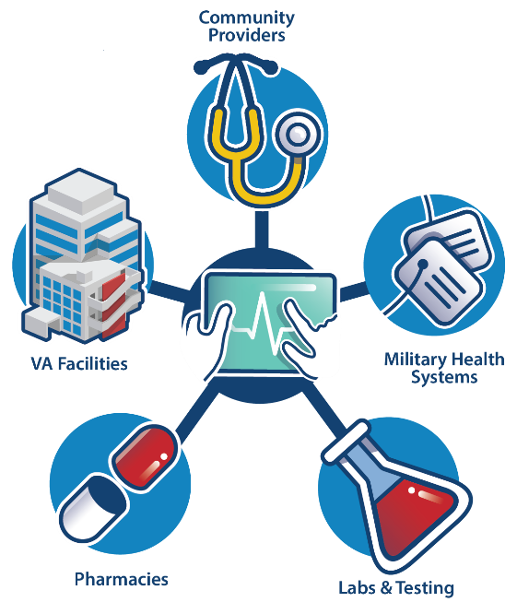
Benefits of the New EHR: Impact
The new electronic health record (EHR) will be a single source of health information for patients and participating providers for both VA, DoD and USCG.
The new EHR will:
Facilitate continuum of care by eliminating the manual transfer of records (military service to Veteran status).
Ensure information is available at the Point of Service (Point of Care) supporting decisions to drive better health outcomes.
Provide Veterans with enhanced access to their complete health record.
Streamline information sharing with community providers.

Slide 5
Challenge: Mindset Changes
Modernizing to standards to support new health care practices
Standardization does not mean lack of innovation or loss of identity
Enterprise system facilitates portability of knowledge
New technologies support changes requested by VHA’s Clinical and Administrative Councils

Slide 6
Challenge: Understanding the Benefits
Current State VHA VistA | Future State Commercial-off-the-Shelf
Development Facility-driven changes Highly customized Variability in measures High sustainment costs Aging technology Once you’ve been to one VA… | Configurable Enterprise-driven changes Standardization Operational efficiencies Investment alignment Modernized technology Consistency
Same mission: To care for him who shall have borne the battle and for his widow, and his orphan.
New paradigm: Enterprise health care practices with modernized infrastructure.

Slide 7
Opportunity: Standardization
One Patient, One Record
Access to health records across VA, DoD, USCG and participating providers
Respect VA medical centers culture
Support high-quality access to care
Interoperability, Portability, Sustainability
Influence industry
EHRM Vision: Each Veteran has a comprehensive health record accessible across the Department of Veterans Affairs, the Department of Defense, U.S. Coast Guard and community care providers to enhance the quality of their health care.

Slide 8
Opportunity: IT Strategic Alignment
EHRM/OIT unified teams to improve outcomes
Cybersecurity
Service Operations Management
Transition Management
On-site Command Center
VA Central Office (DC) Go-Live Technology Cell
Integrated Deployment teams
Strategic planning and alignment
Regular leadership and executive sessions
EHRM CIO Council
Multiyear Planning
Vision-driven Execution
Operational Excellence
Delightful End User Experience
People Excellence

Slide 9
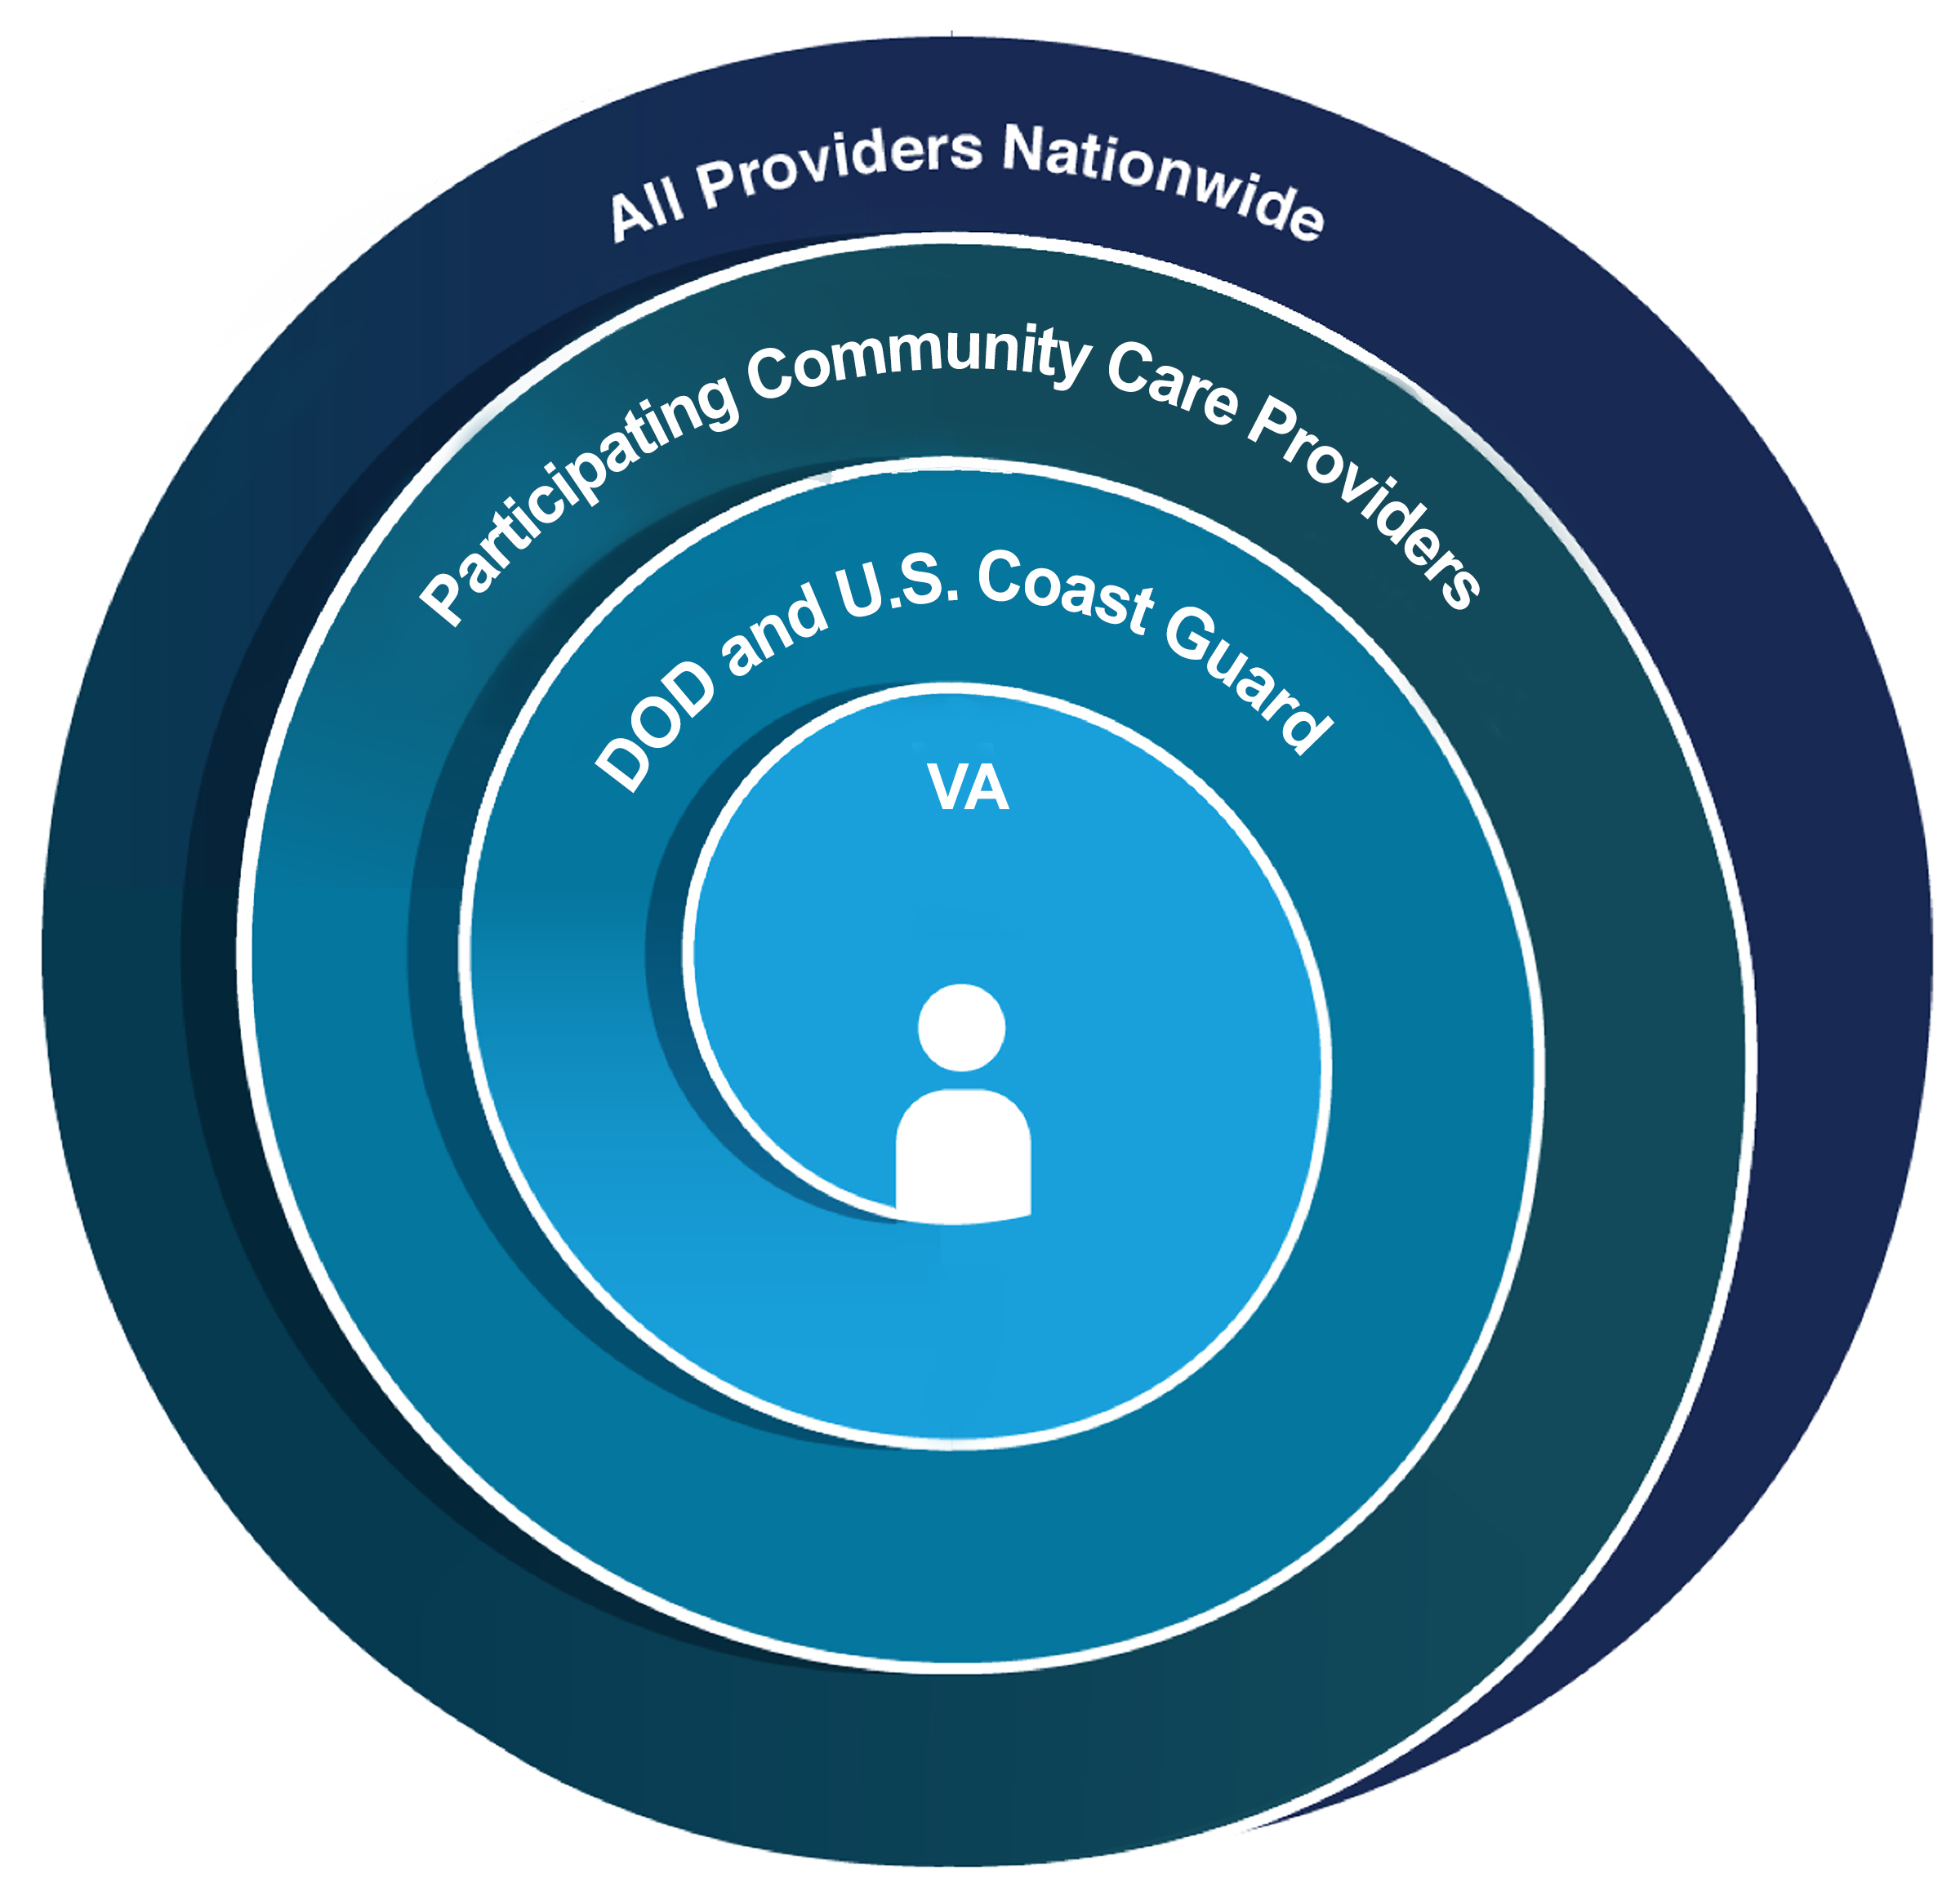
Opportunity: Road to Interoperability
Stage 1: Interoperability within VA
Stage 2: Interoperability with DOD and U.S. Coast Guard
Stage 3: Interoperability with Participating Community Care Providers
Stage 4: National Interoperability

Slide 10
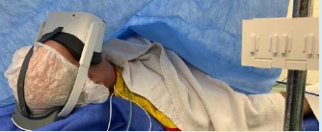
Collaboration: How can industry help?
Focus on CAPABILITIES
Leverage EXISTING standards
Innovation at the Point of Care
Plug and play/magic
Sustainable
Interoperable
Portable
Long-term relationship

Slide 11
Websites of Interest
https://www.ehrm.va.gov/resources/doing-business
https://www.cerner.com/pages/careaware
https://developer.va.gov/explore
https://code.cerner.com/
https://www.oit.va.gov/marketplace/
https://www.oit.va.gov/tech-incubator/lighthouse
https://www.oit.va.gov/services/rpa/
https://www.oit.va.gov/Services/TRM/

Slide 12
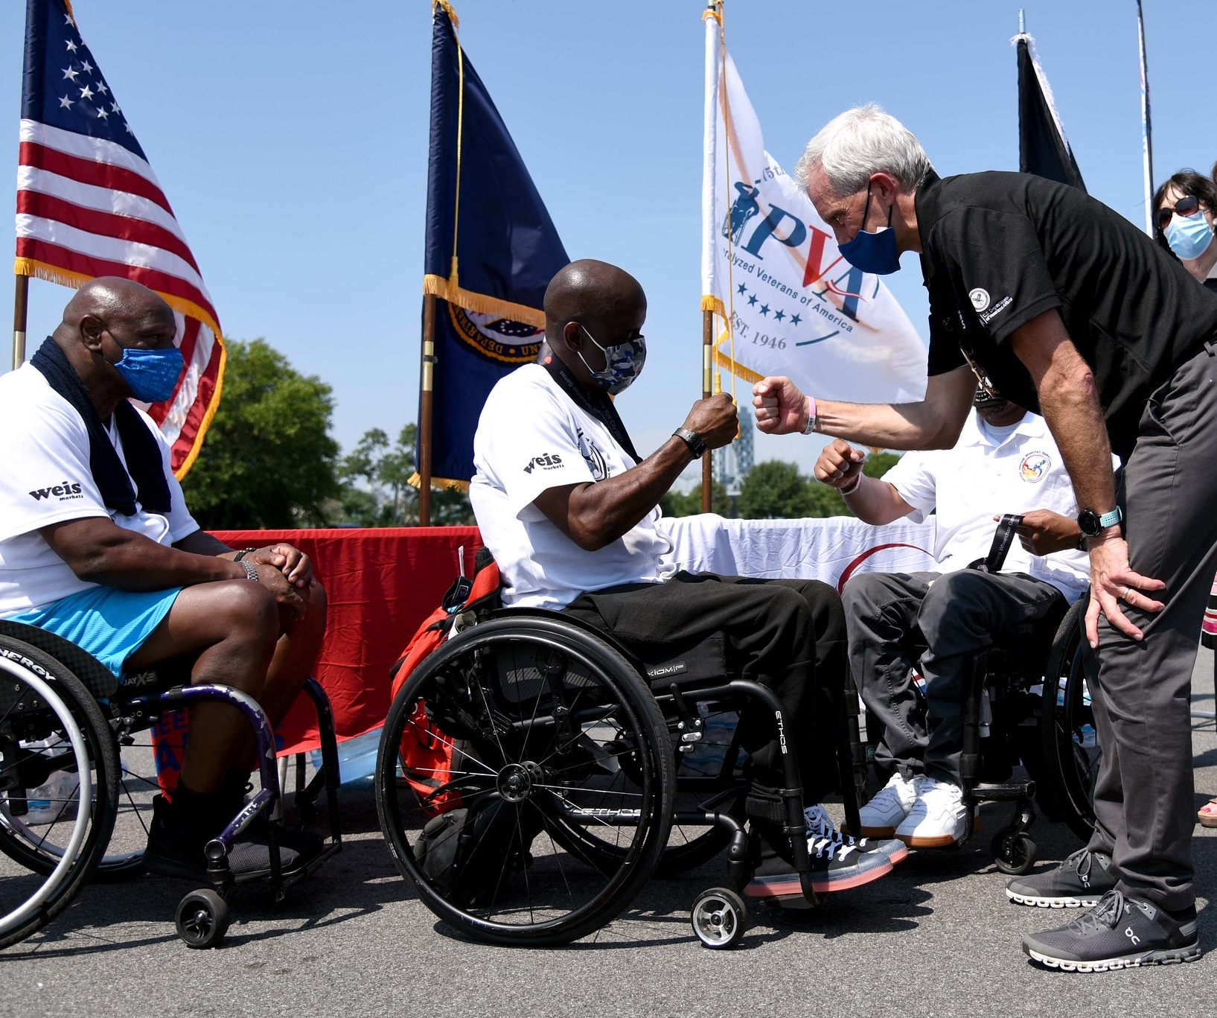
THANK YOU
Learn more at: https://www.ehrm.va.gov
Facebook.com/EHRMVA
EHRM YouTube playlist
Twitter.com/EHRMVA (@EHRMVA)

Slide 13
Questions?

