Slide 1
Federal Networks 2022 Conference
RADM Brian S. Hurley
Director, DISA - Joint Service Provider (JSP)
June 2, 2022

Slide 2
JSP Overview: History
1 May 2015: Deputy Secretary of Defense (DSD) approved the alignment of IT services in the Pentagon and the National Capital Region (NCR) to a “Joint Information Technology Service Provider - Pentagon”
20 July 2015: JSP commenced operations
JSP assumed operational control (OPCON) of the U.S. Army Information Technology Agency (ITA) and the Washington Headquarters Services (WHS) Enterprise Information Technology Service Directorate (EITSD)
1 October 2017: OPCON of JSP transferred to DISA
Two primary Pentagon service models:
On-boarded: Receive all support from JSP (Desktop to Internet)
Transport Only: Receive Pentagon Enterprise Services (Network, Voice/Storage)
from JSP, provide their own unique desktop environment
JSP’s complex mission supports 35+ organizations and 200+ sub-organizations across
5 networks and 15+ geographic locations, with 100+ unique service offerings.
Applications
Remote/Office
Compute
Residences
Cloud
Mobility
Customer
Service
Desk
Printers
VTC
Servers
Voice
Storage
Desktops
Cyber
Network
Transport
JSP: Focused on Pentagon Area IT Customers To Enable Every Mission

Slide 3
Level of Effort Growth - Overview (2015 and Beyond . . . )
Quick turn support for multiple Crisis CMT efforts (NMCC, FEMA, FBI, HHS-OWS)
OUSD I&S expansion College Park Campus
Expansion of HQDA to several bldgs. on Fort Belvoir (network connectivity & end user) HQDA G3, G6, G4, & G8
Support for first ever Chief of Space Operations, of the United States Space Force (USSF)
Support for Cloud solutions
Office standup/move support

Slide 4
Pentagon Enterprise: Current Scope and Scale
3 Network Classifications (NIPRNet, SIPRNet & JWICS) & Life Safety Network – Devices and Ports
10,897 Network Switches
Classification | Onboard | Transport Only
NIPRNet Ports | 35,532 | 48,074
SIPRNet Ports | 7,536 | 9,212
JWICS Ports | 1,984 | 1,906
Circuits and Phone Lines
 | NCR | Pentagon | Ft Belvoir | Total
Circuits | 1,149 | 833 | 150 | 2,132
Phone Lines | 231,000 | 115,000 | 50,000 | 396,000
Wireless
Pentagon | 4,500+ Access Points | Robust / WIDS active
Mark Center | Concourse / select offices | Limited Service
Note: Port Counts pre-COVID
Voice Infrastructure
Unclassified VoIP | 72,500 active lines
Secret VoIP switch | 3,602 active lines
Legacy TDM switch | 5,400 active lines
Mobility Devices |  | Residences |  | VIPs
DMUC | 6,487 | On Base | 35 | OSD | 460
DMCC | 1,006 | Off Base | 10 | Joint Staff | 216
WINDAR | 503 |  |  | Army | 416

Slide 5
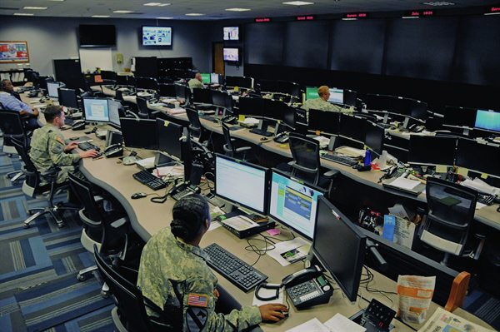
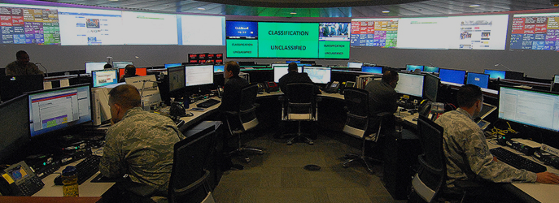
JSP Overview: Key Mission Objectives
Operate
Innovate
Defend
Supporting over 55,000 customers and 75,000 assets
Optimizing over $1B in IT infrastructure

Defending against thousands of potential threats each minute
Providing 100+ IT services to DoD HQ
Migrating core IT services to the cloud
Monitoring over 35,000 security controls
Maintaining 221 mission apps and 9.5 PBs of data storage
$
$
Returning $415M in savings to the Department FY17-22
Resolving several hundred security incidents each month
Notes:
Supporting over 55,000 customers and 75,000 assets
Providing 100+ IT services to DoD HQ
Maintaining 221 mission apps and 9.5 PBs of data storage
Optimizing over $1B in IT infrastructure
Migrating core IT services to the cloud
Returning $415M in savings to the Department FY17-22
Defending against thousands of potential threats each minute
Monitoring over 35,000 security controls
Resolving several hundred security incidents each month
Everything we do here at JSP is in direct alignment with the National Defense Strategy at large. Our support is broken down into three primary objectives – Operate, Defend, and Innovate.
To Operate – we support more than 55,000 customers and 75,000 assets, and that number is growing along with our support of IT and storage services and unique mission applications.
9.5PBs of Data Storage. To provide you a clearer picture, Netflix entire Global Library is 66PBs worth of data.
To Defend – we defend the network against thousands of threats both foreign and domestic every second, including attacks from within our own Department. DoD network is attacked more than any other network in the world. The Pentagon is the primary target for hackers globally both rogue and state sponsored
To Innovate – we are optimizing more than $1 billion in IT infrastructure while focusing on consolidations and savings within our contract portfolio.

Slide 6
DISA JSP: Enable. Every. Mission.
Leveraging DoD CIO, DISA and JSP efforts for continued modernization to the Pentagon IT infrastructure for flexible response in support of changing mission requirements.
14X
5,000+
10X
4x
400%
12,000+
VPN Bandwidth
Surge Procurement
PNT SDN
Increased VPN bandwidth exponentially, adding VPN concentrator at MECPA, BELVA and COLO JRSS Stack
JSP has procured thousands of PPE, ordered 3,500+ MobiKeys, 5,000 laptops, and other mission essential assets
10X BW PNT LAN on
NIPR &SIPR. Next step
Full PNT reservation for all domains
Conference Call Capacity
Network Bandwidth
Increased Remote Capacity
Average daily usage is approximately 4x the previous peak, requiring conference capability upgrades
Increased network bandwidth by 400%, enabling improved response to future pandemics or geographically dispersed workforce requirements.
Combining VPN and MobiKey customers, JSP’s total number of remote users is 12,000+

Slide 7
Joint Service Provider – Opportunities to Excel
Foundational Capabilities
Foundational Capabilities
Enhance the Mission
Enhance the Mission
Deliver Actionable Insights
Deliver Actionable Insights
End User Experience: highly available, secure, and best-in-class performance.
Future of Work: secure mobile collaboration -inclusive of a rich collaborative capability in the Pentagon, in the field, and while mobile in multiple domains
End User Experience: highly available, secure, and best-in-class performance.
Future of Work: secure mobile collaboration -inclusive of a rich collaborative capability in the Pentagon, in the field, and while mobile in multiple domains
Data as a center of gravity: Treat data as a strategic resource. Deploy a holistic data architecture coupled with new capabilities including data lakes and data analysis tools to support warfighters.
Application of AI/ML: Deployment of new techniques to automate capability deployment and defend the JSP mission.
Drastically Increased Deployment Velocity: Adoption of containerization, cloud, and automation technologies to deliver business value at scale and as needed for critical custom application needs.
Radical Visibility: Increased visibility for operations and cyber professionals across the DISA & JSP enterprise while reducing network and endpoint loads.
Data as a center of gravity: Treat data as a strategic resource. Deploy a holistic data architecture coupled with new capabilities including data lakes and data analysis tools to support warfighters.
Application of AI/ML: Deployment of new techniques to automate capability deployment and defend the JSP mission.
Drastically Increased Deployment Velocity: Adoption of containerization, cloud, and automation technologies to deliver business value at scale and as needed for critical custom application needs.
Radical Visibility: Increased visibility for operations and cyber professionals across the DISA & JSP enterprise while reducing network and endpoint loads.

Slide 8
Take Away . . .
DISA JSP serves a unique customer base - the most senior people in the Department of Defense
and their staffs
The scale, complexity and expectations of the Pentagon is challenging
Pre-COVID – 85% onsite, 15% telework
COVID – 85% telework, 15% onsite – in 30 days
Post-COVID – hardware, bandwidth, O365/Teams, SDN, Cloud, LCR
Velocity of action with collaboration to meet demands -- We need your help

Slide 9
QUESTIONS

