Slide 1
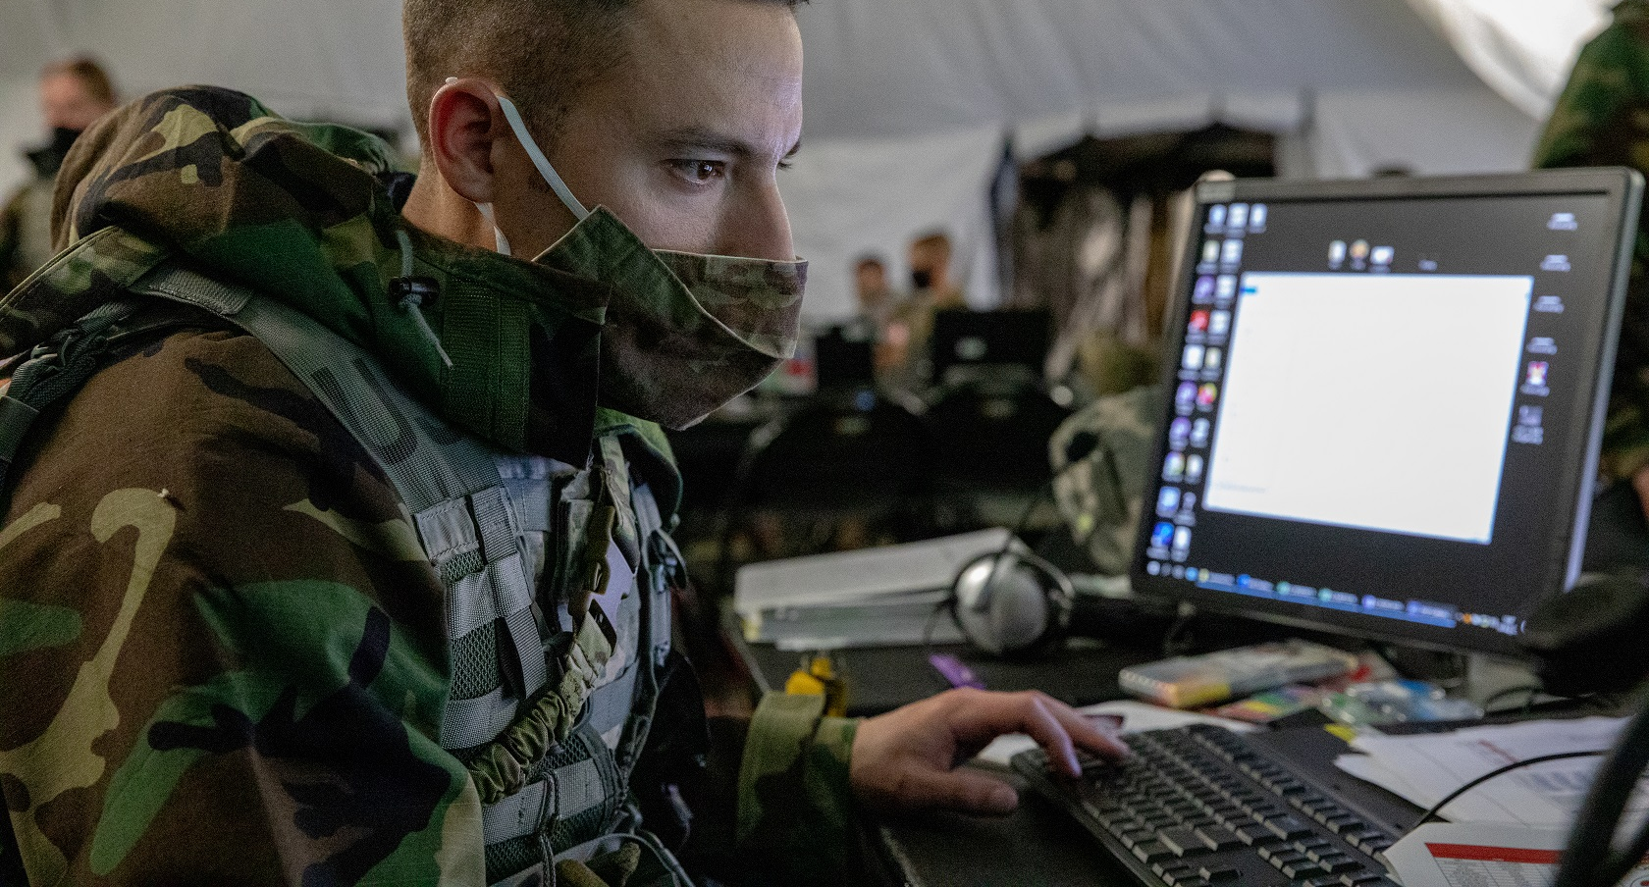
DISA in Action
The nation’s premier
IT combat support agency
Sharon Woods
Director Hosting and Compute Center

Slide 2
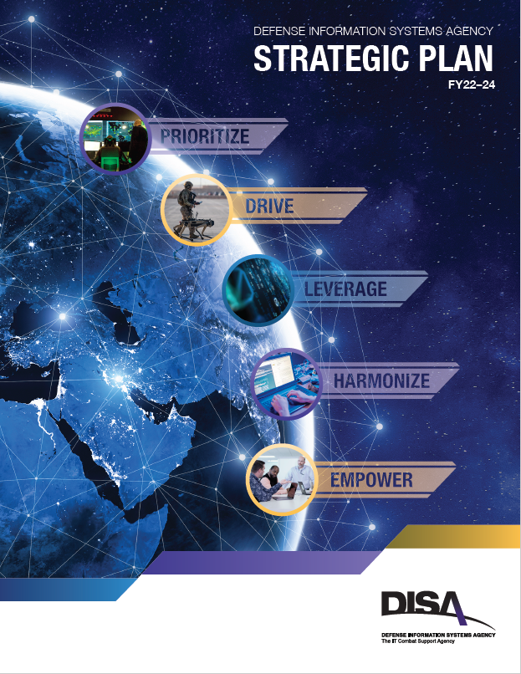
DISA Strategic Action Plan Lines of Effort
1
LOE #1: Prioritize Command and Control (C2)
2
LOE #2: Drive Force Readiness Through Innovation
3
LOE #3: Leverage Data as a Center of Gravity
4
LOE #4: Harmonize Cybersecurity and the User Experience
5
LOE #5: Empower the Workforce
Notes:
Key Points:
-Process coordinated with and mirrors MPEO (Corporate Connections)
-Leverages Salesforce for visibility and historical data
-Provides focus to industry and HaCC to accomplish strategic goals and mission

Slide 3
DISA Strategic Plan Lines of Effort
1
LOE #1: Prioritize Command and Control (C2)
2
LOE #2: Drive Force Readiness Through Innovation
3
LOE #3: Leverage Data as a Center of Gravity
4
LOE #4: Harmonize Cybersecurity and the User Experience
5
LOE #5: Empower the Workforce
Notes:
Key Points:
-Process coordinated with and mirrors MPEO (Corporate Connections)
-Leverages Salesforce for visibility and historical data
-Provides focus to industry and HaCC to accomplish strategic goals and mission

Slide 4
DISA Lines of Effort & HaCC Strategic Goals
2
LOE #2: Drive Force Readiness Through Innovation
Wouldn’t it be cool if…..
Multi-Classification Commercial Cloud | Through the Joint Warfighting Cloud Capability (JWCC), acquire and deliver enterprise-cloud services at all classification levels to support JADC2. The capabilities will be available from headquarters to the tactical edge, to include denied, degraded, intermittent, or limited (DDIL) environments.
Agile Innovation | Holistically implement agile methodologies with a focus on user needs and outcome-based analytics. Drive toward “micro-successes” by achieving minimally viable products within 6 months to get it into the hands of users as quickly as possible to get their feedback and begin the iteration process.
Cloud Adoption Accelerators | Develop cloud adoption accelerators, such as DoD Infrastructure as Code, to enable the rapid deployment of cloud services in a secure manner across multiple cloud service providers.
Private Cloud | Upgrade and enhance Stratus, our private cloud offering, to meet mission partner needs and facilitate hybrid cloud capabilities.

Slide 5
DISA Strategic Plan Lines of Effort
1
LOE #1: Prioritize Command and Control (C2)
2
LOE #2: Drive Force Readiness Through Innovation
3
LOE #3: Leverage Data as a Center of Gravity
4
LOE #4: Harmonize Cybersecurity and the User Experience
5
LOE #5: Empower the Workforce
Notes:
Key Points:
-Process coordinated with and mirrors MPEO (Corporate Connections)
-Leverages Salesforce for visibility and historical data
-Provides focus to industry and HaCC to accomplish strategic goals and mission

Slide 6
DISA Lines of Effort & HaCC Strategic Goals
5
LOE #5: Empower the Workforce
Continuous Learning | Establish a Senior Training Champion to facilitate the consolidation and gap analysis of current training opportunities. Create a training framework that cultivates the “technician of the future” who can operate across all hosting and compute disciplines.

Slide 7
OUR BOTTOM LINE
Driving Change
Prioritizing Resources
Delivering Capability to the Warfighter

