Slide 1
United States Space Force
Space Systems Command
Commercial Satellite Communications Office Overview
Ms. Clare Grason
Chief, Commercial Satellite Communications Office (CSCO)
United States Space Force
2 June 2022
Notes:
The Title is from the Conference Agenda.

Slide 2
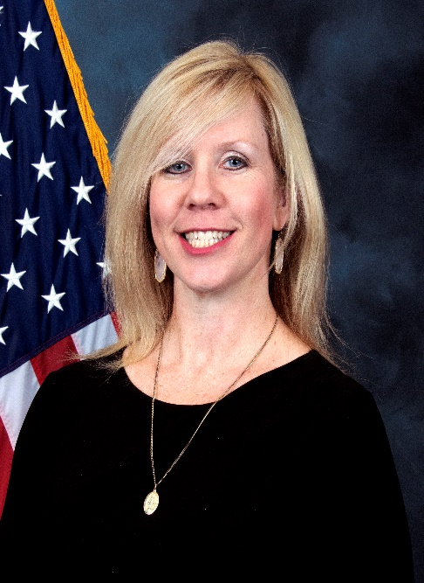
Briefing Topics
CSCO’s Future COMSATCOM Strategy
Top Upcoming Requirements for Commercial Satellite Capabilities, Systems, and Services
Clare Grason
Chief, CSCO
CSCO is the focal point for DoD COMSATCOM Capabilities
Notes:
These bullets are from the Conference Agenda and Clare’s email

Slide 3
COMSATCOM and the SATCOM VISION
SATCOM Vision: An operationally effective, affordable, resilient, and secure satellite communications architecture that supports global mission priorities and is adaptable to rapidly changing requirements, technologies, and threats
COMSATCOM and commercial capabilities have an essential and expanding role within the DOD SATCOM Vision
Remarkable innovations and investment by industry provide opportunities to DoD
Breakneck speed of innovation is bringing new capabilities rapidly to market
Provide DoD with an ability to rapidly expand capacity and capability
Present an unparalleled value proposition for DoD to leverage
Industry innovations that address commercial realities have other military benefits
Commercial economies drive implementations that are militarily desirable – frequency reuse, higher capacities, integrated infrastructures, low-cost terminals
Notes:
The point of this slide is to talk about the SATCOM Vision and the importance of commercial capabilities in realizing that vision. Commercial capabilities are the “home” of innovations currently. There is lots of investment being made and many innovative capabilities being built – cellular from space, commercial imagery and SIGINT, pervasive IOT coverage, etc. These create a compelling value proposition for DOD.

Slide 4
CSCO’s Mission and Focus
CSCO is THE focal point for COMSATCOM across DoD
CSCO a service provider, not just an acquisition shop
A one-stop provider of DoD COMSATCOM services
An integrated component of the DoD SATCOM enterprise
Office is poised to enable expansion into other commercial capabilities
All commercial space capabilities
Stay tuned as the Space Systems Command commercial mission evolves
Priority 1: This Guy
CSCO’s focus is the Warfighter!
Notes:
Not sure about the caption on the picture, but I liked it. Delete it if you don’t.

Slide 5
Future Commercial Services Strategy
CSCO is transforming how DoD acquires and uses commercial capabilities
Implementing an overall, cohesive strategy in support of CSCO’s Mission Partners that further optimizes how DoD acquires and uses COMSATCOM
Demand driven, rapidly available to Warfighter
Not dictating complete MIL-Spec capabilities - incorporating commercial capabilities into operations as appropriate
This strategy creates economies, increases process efficiencies, and enables the USSF SATCOM Vision
Mission Partners
CSCO Service Manager
Aggregated Inventory Requirements
Acquisition Team
Industry Partners
Demand
RFP/
Awards
Order Fulfillment
Capabilities
Notes:
Talk about our aggregating requirements at the CSCO level. Our decoupling of the procurement cycle from the fulfilment cycle to be able to rapidly deploy capability to the warfighter. Capabilities that we by have to be suitable for Military purposes – not military capabilities, but high quality services that work when called upon.

Slide 6
Upcoming Opportunities
CSCO procures over $800M in COMSATCOM services annually
There is a continuous flow of new opportunities coming out of our office
Visit SAM.gov to find our opportunities
CSCO participates in the DISA “Forecast to Industry” events that provide regular updates to industry on anticipated procurement opportunities
These events are announced through SAM.gov as well as on the DISA web site at: https://www.disa.mil/en/NewsandEvents/Events

Slide 7
Highlights of Upcoming Opportunities
Proliferated LEO Services
~$800M Multi-award IDIQ for commercial PLEO services
RFP will be released Summer, 2022
Army SATCOM as a Managed Services (SaaMS)
Pilot phase procurement in development
Will be followed by “production” contract
US Marine Corp Commercial Services
Next generation COMSATCOM support for USMC
Requirements in development, RFP anticipated late this year
Notes:
I put in the opportunities I was aware of.

Slide 8
Questions and Discussion
Clare A. Grason
Chief, CSCO
Office: (301) 225-2030
clare.a.grason.civ@mail.mil

